Slide 1


Slide 2
Maintenance and management of IP Rights
The process of intellectual property management comes into play when businesses need to effectively develop a system that tracks and records IP assets in a streamlined manner. It is also essential in building a strategy dedicated to intellectual property and aligning that strategy with the organization’s overall product and growth goals.
Businesses must treat the process as one that affects internal and external stakeholders because IPM is critical to the development, distribution, and sales of goods and services.
Management of intellectual property is important for businesses because it:
Provides information about intellectual property to the general public.
Establishes, monitors, and documents IP ownerships and rights.
Handles patent portfolios, infringement, piracy, and unauthorized use.
Establishes non-disclosure policies.
Helps to stay updated with competitors and their awards, infringements, and claims.
Documents and prepares licensing and related contracts.
Enables businesses to handle post-issuance proceedings.

Slide 3
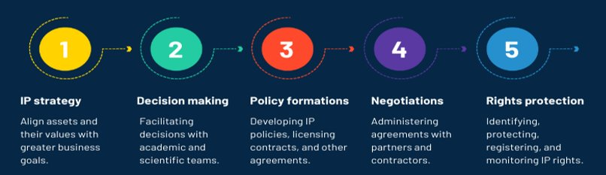
Intellectual Property Management Process

Slide 4
Intellectual property management best practices
1. NONDISCLOSURE AGREEMENTS (NDAS)
Broadly speaking, NDAs restrict use and limit disclosure of your company’s protected information. NDAs offer you legally enforceable protection against accidental and intentional confidentiality breaches by third parties.
With that in mind, before you share confidential information with a third party, make sure to have all recipients sign an NDA first — yes, even if you think they are trustworthy!
2. EMPLOYMENT AGREEMENTS
If you’re engaging a new employee who might contribute to the company’s IP, they should sign an employment agreement before they start work. The employment agreement should clearly define what IP is owned by the company, and how the employee is expected to handle confidential information and other IP during and after the course of their employment.
For more details on what the employment agreement should cover, check out our blog post about effective hiring practices.
3. INVENTION DISCLOSURE RECORDS (IDRS)
IDRs are the most effective way for your company to track IP created by your employees. Essentially, an IDR is used to internally document relevant details about company-related inventions.
All tech companies should have an IDR template that employees complete when they develop new, valuable innovations. The completed IDR can then be used as a starting point for obtaining patent or trade secret protection.
4. IMPLEMENT PROCESS AND INTRODUCE TECHNOLOGY
Leverage intellectual property management solutions along with other legal tools to streamline processes. Such technology helps keep track of applications, documents, and violations of IPR to provide a well-rounded picture of the company's IP assets.

Slide 5
IP Legal Compliance
1. OFFER EMPLOYEE TRAINING AND INCENTIVES
2. USE DATA ENCRYPTION
3. CONTROL WHO CAN ACCESS SENSITIVE INFORMATION
4. CHOOSE THE APPROPRIATE CLOUD-BASED SOLUTION
5. REGULATE USE OF CLOUD-BASED SYSTEMS
6. SECURELY BACK UP IMPORTANT FILES
7. CONDUCT REGULAR TESTS AND AUDITS

Slide 6
Types of Compliance
Contents and behaviour compliance
Legal procedure compliance
This type of compliance means that companies, in certain circumstances prescribed by law, must conduct activities related to the acquisition, transfer, implementation or maintenance of IP rights through government procedures.
This type of IP compliance mainly means that what companies “say and do” shall conform to relevant laws and regulations.
First, with respect to content, various information issued by the companies, and various types of identifications, shall be consistent with the facts and not mislead the public or cause adverse social impact.
Second, the contents must comply with relevant mandatory regulations and avoid infringement on the legitimate rights and interests of others.
Third, behaviour compliance means that companies should take or refrain from certain acts in accordance with laws.
Rules and regulations compliance
This type of compliance requires companies to establish certain internal rules, regulations and procedures related to IP rights such as award and remuneration policy for service inventions, IP rights protection rules for e-commerce platforms, cybersecurity and data privacy protection systems, and research and development data management systems in accordance with relevant laws and regulations.

Slide 7
Avoiding infringements of IP rights by third parties
In order to protect the research results, companies are bound to verify whether the IP rights of third parties are infringed before starting the product development.
The company’s management must establish appropriate monitoring processes, because violations lead not only to civil liability risks, but also to compliance violations and criminal consequences.
IP litigation can be costly – it can also have drastic consequences such as restraints on the use of an IP asset or even monetary compensation/damages. Organisations should ensure that they have a plan in place for such situations.
Organisations should ensure that their IP portfolios are in a state of litigation readiness, by maintaining up-to-date details of the IP assets, and ancillary documents pertaining to their use.

Slide 8
Business IP Advisory for consistent and global IP strategy
An IP strategy is simply a plan—consistent with the company’s business goals—to acquire IP assets and leverage the most value from existing IP assets.
One can develop a strong and effective IP strategy as long as one understands two things: (1) what is worth protecting and (2) what questions to ask when the time comes.
There are four basic IP strategies that organizations can build upon to suit their business objectives.
Risk minimization: This focuses on building diverse IP portfolios and cross-licensing – used by businesses looking to avoid litigation.
Cost reduction: The most common strategy implemented by companies – maintains assets and their effectiveness while cutting unnecessary costs.
Value approach: Organizations seeking to profit from the direct use of intellectual property leverage this strategy.
Tactical approach: Prioritizes the nature and direction of IP-based competition and strategic patenting – Involves shifting the focus of research and development activities and rethinking existing partnerships with customers and relevant parties.

Slide 9

Q&A
This Photo by Unknown author is licensed under CC BY-SA-NC.

