Slide 1


Slide 2






ARTIFICIAL INTELLIGENCE
GV Anand Bhushan
anand@bhushanrajaram.com
9962561012

Slide 3
Artificial Intelligence (“AI”): ‘the science and engineering of making intelligence machines’ (Prof. John Mccarthy)
AI is a field which combines computer science and datasets to enable problem solving.
It allows machines to model, or improve upon, the human mind and perform tasks commonly associated with human cognitive functions, like interpreting speech and writing texts.
Generative Artificial Intelligence or GAI is a novel AI technology that automatically produces new content by utilizing input data. This AI system uses generative modeling and advances in deep learning. In other words, GAI produces diverse content by utilizing existing media such as text, graphics, audio, and video.
It is built on theoretical foundations of (a) machine learning; (b) natural language processing (NLP); (c) image processing; and (d) computer vision.
Out of these, NLP is crucial as it focuses on human language, wherein such language is comprehended by AI to produce content Image processing, in addition, involves analyzing images to acquire new knowledge and generate diverse content from different image collections.
There are 4 common techniques or forms of GAI which are being leveraged in the present times, namely Generative Adversarial Networks (GANs), Generative Pre-trained Transformer (GPT), the Generative Diffusion Model (GDM) and Geometric DL (GDL).
GANs, being one of the most prevalent techniques, use a generator for synthesizing content and a discriminator for evaluating the authenticity of the generator’s content. The GPT models are relevant for generating text in different languages and are capable of creating human-sounding words, sentences, and paragraphs in various writing styles. GDMs generate data from randomly sampled noise through a learned de-noising process whilst a GDL attempts to understand, interpret, and describe AI models in terms of geometric principles. These techniques are, thereafter, used in multiple applications.

Slide 4
Examples of GAI
ChatGPT: This NLP tool, driven by AI technology, interacts conversationally in the form of a chatbot. It is used primarily to answer questions, assist the user with tasks such as writing emails, research papers, essays, and codes.
Dall-E: This is an AI system which creates realistic images and art from a description in natural language. It is a text-to-image model, developed by OpenAI to generate digital images from ‘prompts.’
Google Bard: This is a large language model (“LLM”) which is the text generating part of GAI. It can generate text, translate languages, and write different kinds of creative content. By simply entering a prompt into Bard, the user receives a response which is created using information that is already known to it or which it fetches from other Google services.
Bing AI: Bing AI consists of a Bing Chat, which works similar to ChatGPT and an Image Creator which uses the Dall-E technology to create artwork or images based on user prompts.
Midjourney: Midjourney allows users to create generative creative visuals through specific commands or prompts.

Slide 5
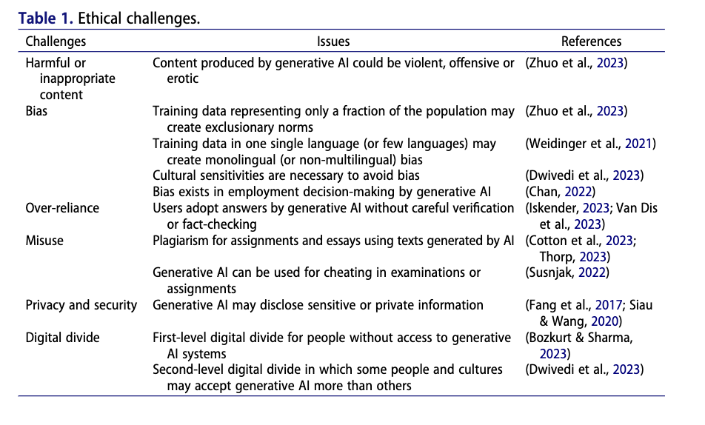
ETHICAL CHALLENGES

Slide 6
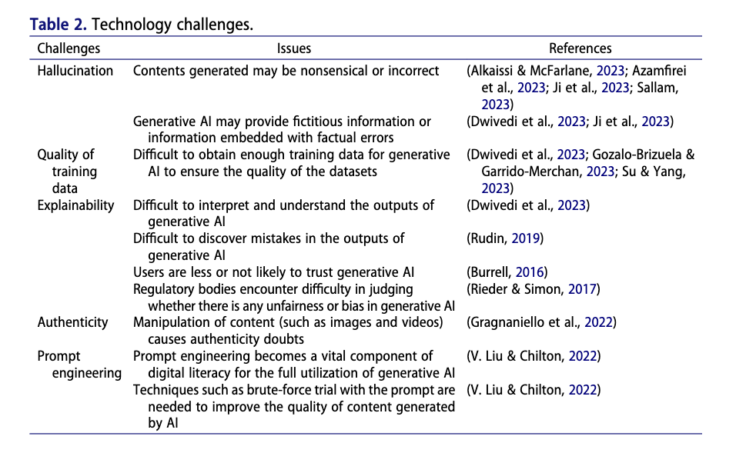
TECHNOLOGY CHALLENGES

Slide 7
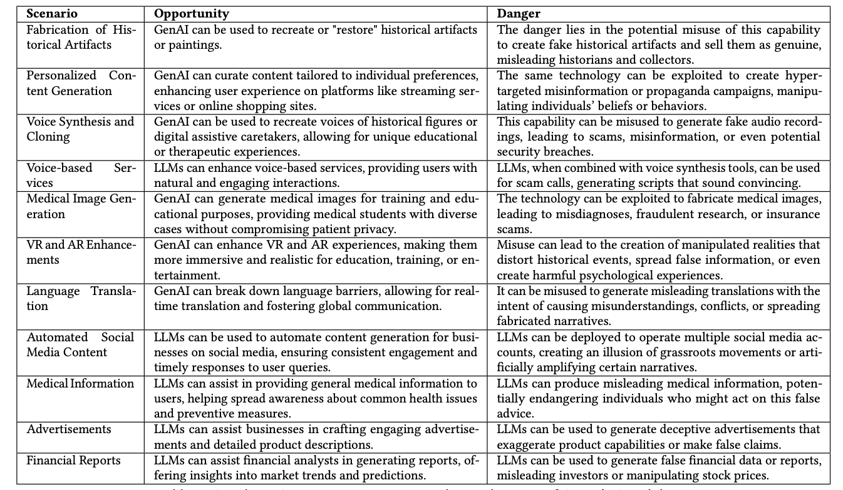
OPPORTUNITIES AND DANGERS ARISING FROM GAI

Slide 8
KEY CHALLENGES RELATING TO AI
PRIVACY
INTERMEDIARY LIABILITY
INTELLECTUAL PROPERTY

Slide 9
AI FRAMEWORKS
NIST AI Risk Management Framework (AI RMF)
NIST stands for National Institute of Standards and Technology.
It’s a U.S. federal agency under the U.S. Department of Commerce. NIST develops measurement standards, technology, and guidance across industries, including cybersecurity and AI.
The NIST AI Risk Management Framework (AI RMF) was issued by NIST itself in January 2023, after a multiyear consultation with industry, academia, and government stakeholders.
Purpose: Voluntary guidance for organizations to design, develop, deploy, and use AI responsibly
Core Functions (M-I-G-P):
  Map – Identify AI context, goals, risks
  Measure – Assess risks (accuracy, bias, robustness)
  Manage – Prioritize and act on risks
  Govern – Embed governance, policies, oversight
Key Features:
  Focus on trustworthiness: validity, fairness, transparency, safety, accountability
  Sector-agnostic, adaptable
  Bridges technical & organizational controls

Slide 10
AI FRAMEWORKS
ISO/IEC 42001:2023 – AI Management System Standard
Overview
First certifiable international standard for AI management systems
Published by ISO (International Organization for Standardization) and IEC (International Electrotechnical Commission) in Dec 2023
Designed to help organizations develop, provide, or use AI systems responsibly
Key Components
AI Policy & Objectives – set by leadership
Governance Framework – roles, responsibilities, and oversight
Risk Management – identification, assessment, mitigation of AI risks (bias, safety, accountability)
Operational Controls – processes for data, training, testing, deployment, monitoring
Continuous Improvement – audits, feedback loops, corrective actions
Certification Benefits
Provides independent assurance of responsible AI practices
Facilitates regulatory compliance (EU AI Act, DPDP India, NIST AI RMF alignment)
Enhances trust and market credibility with clients, regulators, and partners
Improves cross-border acceptance of AI systems and governance
Who It Applies To
AI developers, service providers, and organizations deploying AI in critical business functions
Scalable across startups, enterprises, and government agencies

Slide 11
AI FRAMEWORKS
EU AI Act – World’s First Comprehensive AI Regulation
Overview
Formally adopted by the European Union in 2024
First binding legal framework regulating AI across sectors
Risk-based approach: obligations scale with the risk category of AI system
Key Components
Risk Classification:
  Unacceptable risk (banned): e.g., social scoring, manipulative AI
  High-risk AI: healthcare, employment, education, law enforcement
  Limited risk: chatbots, transparency requirements
  Minimal risk: most consumer apps, no obligations
Compliance Requirements (for high-risk AI):
  Risk management & data quality standards
  Human oversight mechanisms
  Technical documentation & transparency
  Post-market monitoring and reporting
Enforcement & Penalties
Heavy fines for non-compliance: up to €35 million or 7% of global turnover
Market surveillance authorities in each EU member state
AI Office of the European Commission coordinates enforcement
Benefits & Impact
Creates trust and accountability in AI use within the EU market
Establishes harmonized rules across 27 EU countries
Serves as a global benchmark, influencing India’s DPDP Act and U.S. policy discussions
Encourages companies to design AI responsibly by default

Slide 12
AI FRAMEWORKS
AI Governance & Initiatives in India (NITI Aayog, MeitY, Digital India Act, etc.)
1. NITI Aayog — National AI Strategy & Principles
National Strategy for Artificial Intelligence (#AIForAll, 2018)
Lays out India’s roadmap for AI in social sectors—agriculture, health, education, smart cities, mobility—aiming for inclusive growth. NITI AAYOGMorgan LewisWikipedia
Principles for Responsible AI (Part 1, Feb 2021)
Explores ethics principles—transparency, fairness, accountability—spanning system and societal considerations. Morgan LewisWikipedia
Operationalizing Responsible AI (Part 2, Aug 2021)
Moves from ethics to execution: pushes for regulatory tools, capacity-building, and incentives for ethical AI practices. Access PartnershipWikipedia
Ongoing work toward Governance Guidelines (Expected Feb 2025)
A comprehensive framework for AI risk assessment and sector-specific compliance is reportedly on its way. American Chase
IndiaAI Mission & Infrastructure
The government’s big AI push includes: the INDIAai portal (launched 2024), AI Safety Institute (Jan 2025), AIKosha data platform, IndiaAI Innovation Challenge, FutureSkills, OpenAI Academy MoU (June 2025), and development of sovereign foundational models like BharatGen & Sarvam AI. Wikipedia+2Wikipedia+2
2. MeitY — Advisory Role & Digital Rule-Making
Deepfake & Platform Due-Diligence Advisories
As of March 2024, MeitY has advised digital platforms to exercise due diligence—especially regarding deepfakes and misinformation. iapp.org
AI Governance Guidelines Report (Jan 2025)
Encourages activity-based regulation and later moves toward combined approaches. Calls for a whole-of-government stance and formation of an Inter-Ministerial AI Coordination Committee. azbInternet Freedom FoundationSecuriti
3. Digital India Act (DIA) — Future Direction
Proposed Integration with AI Governance
MeitY’s guidance suggests weaving AI governance into the law—anticipating a new regime for adjudication, digital business models, dispute resolution.

Slide 13
CONTRACTS
1. Data Protection & Privacy
Covers lawful collection, storage, and processing of employee, customer, or partner data under DPDP Act (India) and global regimes if data crosses borders. You’ll need to prove minimization, purpose-limitation, and retention controls.
2. Bias & Fairness Controls
Requires documenting how datasets are curated, cleaned, and validated. Protects against discrimination claims if AI influences HR, credit, or service allocation decisions.
3. Intellectual Property & Ownership
Clarifies ownership of training data, model outputs, and derived insights. Prevents later disputes if employees or vendors claim rights over AI-generated material.
4. Audit & Explainability
Mandates keeping logs, testing records, and decision rationales. Ensures you can explain system behavior to regulators, employees, or courts if challenged.
5. Cybersecurity & Access Controls
AI models can be a new attack surface. You’ll need defined controls around model access, API security, and protection against model inversion or data poisoning.
6. Liability & Indemnity
If AI produces harmful or incorrect outcomes internally, liability is usually capped to organizational responsibility. But if using third-party tools, contracts must clearly push liability back to the vendor for defects or misuse.
https://www.hyperstart.com/blog/legal-ai-tools/

Slide 14
PRIVACY
Data is important for training and fine-tuning AI models, and both stages are critical to the machine learning process. Training is the stage where a new model learns from an existing dataset; it adjusts its model weights based on the input data and the corresponding output, often using embedding and activation functions. Fine-tuning, on the other hand, refers to training a previously trained model on new data or otherwise, adjusting an existing model.
In relation to GAI, both these stages require a large amount of data. Such methods are largely privacy-invasive, are trained on sensitive data which reveal personally identifiable information and do not consider user consent or awareness.
One of the most pressing concerns relating to the emergence of GAI technologies relate to privacy.

Slide 15
DATA INTERACTION STAGES
STAGE I: Data Collection (High Risk): Collecting data is the first step to engineer a machine learning model. Several techniques are applied to ensure collection of accurate data and prevent data bias or data imbalance: (a) Pre-cleaned, available datasets; (b) Web crawling and scraping i.e. using automated tools and bots to crawl and scrape existing websites for data; (c) Private data i.e. creation of own data by machine learning engineers; and (d) Custom data i.e. creation or crowd sourcing of data for a fee.
For GAI, most training data is scraped from publicly available web pages which is likely to contain sensitive content or content that is erroneous, pornographic or potentially harmful. The risk of privacy infringement is the highest at this step.

Slide 16
DATA INTERACTION STAGES
Data Scraping
Data scraping involves extracting publicly available information from online sources, which encompasses two main methods: website scraping and screen scraping. Website scraping retrieves data from a website's URL, text, and HTML code, while screen scraping mimics end-user actions to extract visual data.
This process is commonly used to amass large datasets for various analytical purposes, such as market research, lead generation, competitive analysis, and sentiment analysis.
Invisible processing, a concept emerging in data protection, occurs when personal data is acquired from sources other than individuals themselves, without providing them with mandated privacy information, as per Article 14 of the UK GDPR or the Data Protection Act.

Slide 17
DATA INTERACTION STAGES
Data Scraping
This lack of transparency leaves individuals unaware of their data's collection and utilization, hindering their ability to control its usage and exercise data protection rights effectively.
Despite the absence of immediate negative effects, this opacity undermines fundamental principles of fairness, transparency, and individual autonomy in data handling practices.
In the context of AI, large language models (LLMs) require extensive datasets, including user-generated content, for algorithm training. This leads to indiscriminate scraping of personal information, such as names and addresses, from platforms like Wikipedia, Twitter, developer forums (e.g., Reddit, Stack Overflow), and e-commerce websites (e.g., eBay), to train LLMs effectively.

Slide 18
DATA INTERACTION STAGES
Data Scraping
Companies engage in data scraping without explicit consent using various techniques and technologies to overcome challenges and efficiently extract desired data.
These challenges include dynamic web content, website structure changes, and anti-scraping measures deployed by websites to deter unauthorized data extraction.Court cases, such as hiQ Labs v. LinkedIn, have played a significant role in shaping the legal landscape surrounding data scraping and invisible processing without consent.
In the hiQ Labs case, the court ruled in favor of hiQ Labs, affirming the legality of scraping publicly available data from LinkedIn's member profiles. The court's decision underscored that scraping publicly available data may not necessarily constitute unauthorized access under the Computer Fraud and Abuse Act (CFAA), especially when prior authorization is not required.
ongoing legal debates and cases, such as Meta v. Bright Data and Crowder v. LinkedIn Corp., continue to explore issues related to termination of online platform relationships, antitrust violations, and market division concerning access to public data. These cases highlight the complexities and nuances surrounding data scraping and invisible processing, underscoring the need for ongoing legal scrutiny and regulatory guidance in this rapidly evolving landscape.

Slide 19
DATA INTERACTION STAGES
STAGE II: Data Training (High Risk): This step involves teaching machine learning algorithms to recognize patterns and make predictions. This happens by feeding a large amount of data into a machine learning algorithm so that it can learn to recognize patterns and make predictions about new, unseen data.
The three types of AI training data are: (a) supervised learning datasets where the training data is labeled and consists of images, texts and associated output labels; (b) unsupervised learning datasets where the data is unlabeled and the algorithm has to find patterns in the data by itself; and (c) reinforcement learning datasets where the training data consists of the agent’s interactions with the environment such as rewards or penalties for certain actions. Here too, the risk of privacy invasion is high.

Slide 20
DATA INTERACTION STAGES
STAGE III: Evaluation and Refinement (Low Risk): At this stage, the model is evaluated to see how well it performs, by testing it on unseen data and then analyzing its predictions. If the performance is not satisfactory, it could lead to adjusting its parameters or going back to the data acquisition stage to gather additional data.
STAGE IV: Deployment (Low Risk): This step concerns deploying the GAI model to a production environment. This may involve integrating the model within existing systems or creating an application that uses the model, where it starts to operate in real-time, offering solutions or answers to the user. In this case, the model takes in new data which is not likely to be part of the training cycle. After deployment, the model is also required to be maintained and updated.

Slide 21
RISKS ARISING FROM DATA INTERACTION
Data Handling and Consent: GAI technologies are trained on a large volume of datasets and can produce results that are likely to be prejudiced and tainted in bias and risks. The risk lies in violating data protection laws like India's Personal Data Protection Bill, GDPR for European users, or others. Beyond the documented harms to individuals, AI systems also pose considerable societal privacy risks that existing regulations are ill equipped to address.
Automated Decisions: GAI relies heavily on high-quality data for decision making. However, where incomplete, inaccurate or biased data is collected, it can lead to flawed decisions and outputs and such automated decisions are likely to affect users, raising concerns about consent and transparency. GAI decision-making systems can also raise ethical concerns and develop unwarranted trust in AI machines.
Cross-Border Data Transfer: Whilst cross-border data flows are becoming increasingly important in the AI or GAI conversations, the emerging regulatory approaches and existing privacy laws across countries are likely to hinder the deployment of AI globally, restrict access to data and perhaps also require duplication of technologies. In addition, unauthorized transferring of data across borders can create compliance issues with various national privacy laws.

Slide 22
RISKS ARISING FROM DATA INTERACTION
Surveillance Concerns: There is is growing use of smart solutions including biometrics, facial recognition, smart cameras and video surveillance systems which are helping create and deliver security services, build trust and strengthen association with communities. Use of GAI in surveillance, potentially infringes on privacy rights. Kok Yam Tan, Deputy Secretary of Smart Nation and Digital Government Office Singapore explains, “Whether it is about sensors, CCTVs, digital contract tracing, it is very important for us to be sensitive to how people feel about the data collection and data use, and we must communicate and be very clear about what we are doing.” Using AI for surveillance must be considered in the context of the existing freedom of citizens and communities at large.
User Profiling and Anonymization: Data sharing between media platforms and businesses is common owing to the onset of AI. However, creating detailed user profiles without consent, coupled with inadequate anonymization, poses a risk of re-identification of the data subject/user, thereby compromising the individuals' privacy rights.
Biased AI Outputs: AI bias refers to such systems which produce biased results that reflect and perpetuate human biases within a society, including historical and current social inequity. Such bias can be found in the data training stage, within the algorithm or the deployment stage. Unaddressed biases can hinder people’s ability to participate in the economy or society and such systems can also foster mistrust among marginalized groups.

Slide 23
RISKS ARISING FROM DATA INTERACTION
Transparency in Operations: Transparency is the systematic transference of knowledge from one stakeholder to another: the data collectors being transparent with data scientists about what data was collected and how it was collected, and in turn, data scientists being transparent with executives about why one model was chosen over another. The goal of being transparent is to ensure trust, decrease the risk of error and misuse and express respect for all people involved. Lack of transparency reduces trust in users towards AI systems and increases chances of legal action against AI developers for negligent or malicious content.

Slide 24
LIABILITY RISKS AND REGIMES
In India, under Section 2(1)(w) of the Information Technology Act, 2000 (“IT Act”), an intermediary is defined as, “any person who on behalf of another person receives, stores, or transmits that record or provides any service with respect to that record and include telecom service provides, web-hosting service providers, search engines, online payment sites, online auction sites, online market places, and cyber cafes.”
An intermediary is a party that serves as a link between two other parties to facilitate communication between such parties. An intermediary does not create any information by itself. It only receives, stores, and transmits information that may be created by other parties.
An intermediary may be used to facilitate transactions between buyers and sellers, manage flow of information between parties, and provide platforms that connect buyers and sellers, service providers and customers and other parties.

Slide 25
LIABILITY RISKS AND REGIMES
In 2021, the Ministry of Electronics and Information Technology notified the new Information Technology (Intermediary Guidelines and Digital Media Ethics Code) Rules, 2021 (“Intermediary Rules”).
These rules define a ‘social media intermediary’ under Rule 2(1)(w) as “an intermediary which primarily or solely enables online interaction between two or more users and allows them to create, upload, share, disseminate, modify or access information using its services”.
For example: Meta’s primary role involves providing a platform for social media interaction and content sharing. It offers the infrastructure for people to connect, share information and communicate on the various platforms that it operates including Facebook, Instagram and WhatsApp. So, it facilitates online social interactions as an intermediary. Meta allows users to share various forms of content such as text, images, videos on its platforms. Here, Meta is an intermediary for dissemination of content between users.
Meta is also a data intermediary; it collects and manages user data to personalize experiences and act.

Slide 26
TYPES OF INTERMEDIARIES (AI)
An intermediary within the context of AI acts as a bridge, enabling different components or entities to work together seamlessly, contributing to the overall functionality and effectiveness of AI systems.
DATA INTERMEDIARIES: A data intermediary acts as a cooperative where data from multiple sources is pooled together. It is a platform which collects, processes and manages data before it is fed into an AI model. The intermediary is responsible for managing access to that data and could involve data cleaning, processing and ensuring that it is in a suitable format for the AI algorithms.
APPLICATION PROGRAMMING INTERFACES (“APIs”): APIs are mechanisms that enable two software components to communicate with each other using a set of definitions and protocols. APIs act as an intermediary layer that process data transfers between systems, letting companies open their application data and functionality to external third party developers, business partners and internal departments within their companies. APIs can enable the integration of AI models into existing software or platforms to allow for seamless interaction.

Slide 27
TYPES OF INTERMEDIARIES (AI)
MIDDLEWARE: This is a software that different applications use to communicate with each other. By making it easier to connect applications that weren't designed to connect with one another, and providing functionality to connect them in intelligent ways, middleware streamlines application development and speeds time to market. In AI systems, middleware can be used to integrate various components of a larger AI infrastructure.
HUMAN-AI INTERMEDIARY: Where AI systems interact with humans, an intermediary could be a user interface or a chatbot which facilitates communication between the user and the AI system to make the interaction more user-friendly and understandable.
MODEL SERVING PLATFORMS: Such platforms act as intermediaries between trained AI models and the applications or systems that use them. They handle tasks such as deploying models, managing resources and handling requests, making it easier to integrate AI capabilities into various applications.

Slide 28
MARKET PARTICIPANTS IN THE AI/GAI VALUE CHAIN
FOUNDATION MODEL DEVELOPER: Foundation models are a form of GAI and are deep learning neural networks which are trained on a broad spectrum of generalized and unlabeled data and are capable of performing a wide variety of general tasks such as understanding language, generating text and images and conversing in natural language.
GPT-4, for example, trained by OpenAI is a foundation model which uses 170 trillion parameters and a 45 GB training dataset.
Foundation models use self-supervised learning to create labels from input data i.e. no one instructs or trains the model with labeled training data sets.
A Foundation Model Developer is a person/organisation who develops a Foundation Model or has a Foundation Model developed to place it in the market, whether for payment or free of charge.

Slide 29
MARKET PARTICIPANTS IN THE AI/GAI VALUE CHAIN
MODIFIED AI SYSTEM DEVELOPER: Athird party developer who makes modifications to the Foundation model through fine-tuning processes and releases the same as a separate AI system. They largely work with and/or on AI technologies where the source code is freely available for anyone to use, modify and distribute.
DEPLOYER: A deployer is a person who deploys or uses an AI system under its own authority, except where the AI system is used in the course of a personal, non-professional capacity. An organisation can act as both, a developer and a deployer. For example, a cybersecurity company develops an AI software that monitors network traffic and customer transactions and then uses it on its own platform. It may be possible that the deployer substantially modifies the AI system pre-deployment, in which cases the developer may no longer be considered as the provider/original developer.

Slide 30
MARKET PARTICIPANTS IN THE AI/GAI VALUE CHAIN
LICENSEE: A licensee is a person or user which accepts a license from the provider to an AI-based software or is granted access to cloud services containing the AI. There can be on-premises licenses of AI where the licensee or user installs, trains and operates the AI solution or a subscription to software as a service (SaaS) or other cloud services where the licensee or user access the AI solution in the cloud via and the internet and it is usually the provider or licensor who trains the AI solution.
END-USER: An end-user is the person or organisation that uses the AI system for personal or commercial purposes.There may be certain AI systems, the operation of which, is driven by the actions of the end-user, since the output is generally determined by the prompts given by such end-user. The end-user may deny the developer or the deployer their ability to initiate, select or modify the information generated or the recipient of such user.

Slide 31
INTERMEDIARY LIABILITY
Collecting inaccurate, discriminatory and imbalanced data leading to malfunctions in the AI system and incorrect or undesirable outputs
The type and composition of training data may be biased, leading to potential liability. Intermediaries may be required to verify the quality of data as biased data can result in incorrect output, leading to personal injuries or denial of key life opportunities.
Intermediaries are also at risk of using data without proper consent, leading to violation of privacy laws.
Intermediaries may be at risk if the data they handle does not meet legal and contractual standards for privacy, transparency, non-discrimination.
Creators may be held liable for collecting data in ways that violate intellectual property laws or data protection laws.
The training of models on open-source data sets scraped from the web without proper licenses can lead to legal challenges

Slide 32
AI AND INTELLECTUAL PROPERTY
The fundamental goal of the IP system is to encourage innovation through new technologies and creative works. This includes human created as well as AI created, inventions and works.
AI also provides a general use technology to assist in the application, management and administration of IP systems and tools.
There is an ongoing debate whether those frameworks and systems need to be modified for machine created inventions/works. In broad terms, the discussions regarding machine created inventions/works are focused around:
potential protection for the actual machine created work/invention itself. This tends to focus on the question whether AI be an inventor or creator within the existing IP frameworks.
potential protection of the AI algorithms and software.
potential rights concerning the underlying training data and data inputs.
There is also a debate around where the line between human creation and machine creation is to be drawn, i.e. how much or how little human input or guidance may be required to fall within one or the other.

Slide 33
AI AND INTELLECTUAL PROPERTY
At the heart of many AI and ML platforms are large quantities of material from which the system learns: for example, text from articles, websites, books and academic papers in the case of OpenAI’s ChatGPT; computer code in the case of GitHub Copilot; or artworks in the case of DALL-E or Midjourney.
Those materials are themselves products of human intellectual effort and often protected by IP rights, such as copyright.
Use of copyright-protected material without permission may constitute infringement. Whether use of that material in the AI's development is lawful – including digital reproductions used solely within the AI system – depends on copyright infringement defences that differ between jurisdictions.
The black box nature of AI systems presents practical hurdles for IP owners seeking to protect their rights. The fact that it is difficult, or impossible, to know what a computer system does with material it is provided for learning means it may be more challenging, for example, for a copyright owner to establish an AI system made unauthorised use of their work, or a patent owner to establish an AI implements a method claimed by their patent.

Slide 34
AI AND INTELLECTUAL PROPERTY
Apart from use by AI, IP rights can be infringed by outputs produced from computer systems.
A recent class action filed against Microsoft in relation to GitHub Copilot alleged, in addition to copyright infringement by the use of code from GitHub to train the system, that asking Copilot to create code achieving particular functionalities would substantially reproduce code Copilot had been trained on.
Even if materials used to train AI are open source, they can be subject to “copyleft” licences, which require that any derivative works are in turn licensed on terms that are no less restrictive.
IP protection encourages investment in creative and inventive outputs. It remains unclear how those safeguards apply when an AI system is used either as part of that process of creation, or indeed whether an AI can be considered the creator or inventor itself.
Following attempts by Dr Stephen Thaler to have the AI system known as DABUS registered as the inventor of a patent, courts in the US, Australia, the UK and the European Patent Office each concluded an AI cannot be an inventor for the purposes of patent law as currently drafted. The law as it stands requires a human to be the inventor.
However, both the UK and Australian courts emphasised that this was not the same question as whether an invention made using, or by, an AI system could be patentable.

Slide 35
AI AND INTELLECTUAL PROPERTY
In doing so, the question has been raised – but yet not answered – how the increasing use of AI might affect questions such as determining whether a patent for an invention involves an “inventive step”, which is required for it to be valid. Inventiveness in patent law is judged in terms of the step not being "obvious" to the person skilled in the area of technology into which the invention falls.
Where AI is used to generate creative outputs, like literary works, computer code or art, copyright would be the usual domain for legal protection. However, in Australia, the UK and Europe, the courts have emphasised the essential nature of human creativity, both as to whether copyright subsists at all and on scope of protection it affords.
The process of training an AI or ML system on those inputs almost certainly involves the creation of a copy (in a copyright sense) – and most likely many copies – of those copyright works, even if those copies are only ever used “internally” within the system (eg in training the system) and never reproduced as outputs from it.
This kind of copying is among the key allegations in proceedings brought by Getty Images against Stability AI (Getty Images).

Slide 36
AI AND INTELLECTUAL PROPERTY
Getty Images, a global media provider distributing royalty-free images, photos, music and video, has sued Stability AI in the UK and US for allegedly using over 12 million of its copyrighted images and associated captions and meta-data to train its AI text-to-image tool, Stable Diffusion, without consent or compensation.
Authors including Jodi Picoult and George RR Martin have also sued Open AI in the US, (Authors Guild, et al. v. OpenAI, Inc.) alleging the infringement of fiction authors’ rights in the AI system’s wholesale copying of their works, without permission or compensation, to train its large language models (LLMs). They also argue that the output of these LLMs are derivative works which mimic or paraphrase the authors’ work and harm the market.

Slide 37
CHALLENGES
No singular definition of AI or GAI
Uncertainty around inventorship and ownership for patent protection of AI
Unclear patentable subject matter and patentability guidelines within the context of AI
How to assess non-obviousness or inventive step in AI?
Uncertainty around authorship and ownership for copyright protection of AI. The problem of identifying an author includes: there is no author, or the author is the creator of the AI system, having enable the creating of the work by building and training the system or the author is the user of the AI system, having instructed the system to create the work or a combination of all
Assessing originality of the work
How to assess infringement and at what step of the data stages?
How to prove that a particular copyright work was part of the training data?
Whether ‘Fair Use’ doctrine justifies the use of copyrighted works to train AI models (during data scraping/web crawling)?
Jurisidicitional consideration such as where did the act of infringement occur
Many IP laws do not protect machine-generated works

Slide 38
EXAMPLES
The Next Rembrandt: An example of GAI created artwork, through the utilization of ML process, is “The Next Rembrandt”, a 3-D printed painting, created after analysing the works of 17th -century Dutch artist Rembrandt Harmenszoon van Rijn. This artwork was created with the collaboration of various persons and entities, along with the AI system. This creation raises crucial questions for the IP laws across various jurisdictions, as there will be more such cases in the future where IP laws will need to address such issues for the proper determination of rights of the AI systems and the natural person.
DABUS: across various jurisdictions, such as Australia, the United Kingdom, the United States, New Zealand, and the European Patent Office, applications filed by Stephen Thaler to patent the inventions by his AI system Device for the Autonomous Bootstrapping of Unified Sentience (“DABUS”), were rejected in the abovementioned jurisdictions on the ground that their patent laws do not allow the grant of patent to an AI system as the inventor, since a common classification in their patent laws only consides a natural person to be named as the inventor in a patent application.

Slide 39
EXAMPLES
The case of DABUS is a landmark in the field of patents and AI systems, as South African Companies and Intellectual Property Commission (“CIPC”) accepted Stephen’s Patent Cooperation Treaty, on 24th June 2021, for a patent in respect of inventions made by DABUS. In July of 2021, CIPC released a notice of issuance for the patent, and DABUS became the first AI system to be regarded as an inventor and granted a patent for its inventions.
RAGHAV:Like DABUS, the copyright office in India, albeit mistakenly, has recognised an AI system RAGHAV as the co-author of an artistic work and registered the application for copyright protection. However, in the first instance, when Ankit Sahni, the creator of the AI system RAGHAV, filed the application listing the AI system as the sole author of such work, had that application rejected by the copyright office. Later, the copyright office issued a notice for withdrawal of such registration, as it had mistakenly granted the registration and asked the human co-author Mr. Sahni to deliberate upon the legal status of the AI system RAGHAV.

Slide 40
EXAMPLES
Creativity Machine: In a landmark judgment by the US Court neither the owner of the machine (since it’s the machine that created work) nor the machine itself (since it is not a person) got registration as an author under copyright laws. The United States District Court for the District of Columbia, vide an order dated 18th of August 2023, in Stephen Thaler v. Shira Perlmutter, Register of Copyrights and Director of the United States Copyright Office, the principal issue of whether work autonomously generated by an AI system is copyrightable in the United States was discussed and decided upon.
In concluding the discussion in this case, the court held that, “the work at issue did not give rise to a valid copyright upon its creation’, and ‘the image autonomously generated by the plaintiff’s computer system was never eligible for copyright’, upholding the decision of the Register in denying copyright registration to a ‘work created absent any human involvement’

Slide 41
CURRENT REGULATORY REGIME (AI)
European Union
On March 13, 2024, the European Parliament voted in favor of the EU AI Act. The AI Act is a set of rules designed to make sure that AI technology is used in a responsible and fair manner in the EU market.
The AI Act aims to introduce: (a) due diligence obligations in the development of the AI system from the outset; (b) mechanisms to verify the correctness of the decision; and (c) avenues to hold individuals accountable if the decision is found to be incorrect.
The AI Act will apply to a wide range of players in the AI field, and beyond the EU's borders
The AI Act classifies AI systems into different risk categories: minimal or limited, high, and unacceptable risks. This classification is based on their potential impact on users and society. High-risk AI systems are subject to more stringent requirements, while AI systems posing an unacceptable risk are prohibited. This approach is similar to the GDPR’s risk-based approach to data processing.
The AI Act puts a hard stop on certain AI practices. The Act prohibits any AI system that tries to manipulate human behavior, exploit vulnerabilities, or support government social scoring. It says no to biometric categorization, predictive policing, and software that scrapes facial images from the internet to create databases

Slide 42
CURRENT REGULATORY REGIME
European Union
AI systems designed for emotion recognition will also be banned, especially in workplaces, education, and law enforcement. Furthermore, using AI systems for affecting people's behavior in ways that could cause harm or exploit their vulnerabilities will be prohibited.
Under the AI Act, providers of AI foundation models and general-purpose AI systems will be subject to extensive documentation, transparency, and registration obligations. Even before a foundation model is launched, providers will need to show through design, testing, and analysis that they've mapped out and mitigated any foreseeable social and security risks. They will be required to register their foundation models in a newly established EU database.
Alongside the AI Act, other important legislations in the realm of AI are in the pipeline. Notably, the proposed AI Liability Directive aims to clarify civil liability concerning damages induced by AI systems.
United Kingdom
In March 2023, the UK government issued a whitepaper on its domestic AI regulation. Through this, the UK aims to create a pro-innovative regulatory framework, focusing on the context in which AI is deployed, rather than the technology itself.

Slide 43
CURRENT REGULATORY REGIME
United Kingdom
At the heart of the UK’s framework are the principles of (a) safety, security and robustness; (b) appropriate transparency and explainability; (c) fairness; (d) accountability and governance; and (e) contestability and redress.
The following key regulations provide the UK with its current framework for AI regulation:
Data Protection Act 2018 / General Data Protection Regulation (GDPR). The Data Protection Act 2018 is the UK's implementation of the GDPR, an EU privacy regulation that has been incorporated into UK law, and governs how personal data should be handled by businesses and organisations, ensuring that individuals' privacy rights are respected. Any AI system processing personal data must do so in a way that respects these rights.
Human Rights Act 1998. This Act incorporates the rights set out in the European Convention on Human Rights into UK law. These rights include the right to respect for private and family life, which can be impacted by AI systems, particularly those that process personal data or make automated decisions about individuals.
Equality Act 2010. This Act prohibits discrimination in various areas of public life, including employment and the provision of services. If an AI system is used in a way that results in discrimination, such as biassed hiring practices or unfair service provision, the organisation could be in breach of the Equality Act.

Slide 44
CURRENT REGULATORY REGIME
United Kingdom
Product and sector-specific legislation may also apply to AI that has been integrated into some services or products. Specifically, this may include legislation for financial services, electrical and electronic equipment, medical devices, and even toys.
The UK government is trying to introduce a more streamlined regulatory landscape.
United States of America
While the U.S. lacks a unified AI regulation, it has established numerous guidelines and frameworks to govern the AI sector on a federal level.
Executive Orders, such as: Maintaining American Leadership in AI and Promoting the Use of Trustworthy AI in the Federal Government Act
Legislations and Proposed Bills such as: AI Training Act, National AI Initiative Act, Algorithmic Accountability Act (proposed), Transparent Automated Governance Act (proposed) and Global Technology Leadership Act (proposed)
The US is adopting a case-by-case strategy to AI governance enforcement, avoiding an overly precautionary approach.

Slide 45
CURRENT REGULATORY REGIME
China
China stands at the forefront of jurisdictions who are actively introducing AI regulations. several specific AI applications are already governed by existing rules. These encompass: Algorithmic Recommendations Management Provisions, Ethical Norms for New Generation AI, Opinions on Strengthening the Ethical Governance of Science and Technology. AI governance initiatives in progress include: Draft Provisions on Deep Synthesis Management and Measures for the Management of Generative AI Services.
China’s regulations aim to address risks related to artificial intelligence and introduce compliance obligations on entities engaged in AI-related business.
China's AI governance framework attempts to address multiple interconnected yet distinct legal issues originating from the technology including:
The content and information generated and disseminated online:
The first pillar of China’s AI regulatory regime concerns the governance and management of online content. regulators will prioritise traceability and authenticity of the content to restrict circulation of information that would violate well-established information services regulations.
This will take on many dimensions in the context of enforcement. There will be an obligation on service providers to add a watermark informing users that a particular piece of content (whether visual, auditory, or textual) is generated by AI. Companies have the obligation to mark content that could cause confusion or misidentification by the public

Slide 46
CURRENT REGULATORY REGIME
The content and information generated and disseminated online:
Lawful content: These requirements build off other recent laws and regulations that aim to ensure that platform companies respect social and moral norms and delineated political directions and do not enable the spread of undesirable information. Indeed, recent enforcement and guidelines from the CAC indicate that this includes, for instance, unsubstantiated rumours, false information that could cause public panic, pornography, and other content unsuitable to children, and social media posts that fuel addiction or unsafe consumptive habits. Under the 2023 Generative AI Measures, providers that detect such information must report it to the authorities and restrict users from creating or spreading it
Content moderation is also a key theme in the recent concept of services with "public opinion attributes or social mobilisation capabilities." This term is used in each of the key AI regulations and denotes a class of service providers that are subject to heightened regulatory compliance obligations due to their ability to spready information to a large group of people. These services must not only meet dedicated filing requirements for their recommendation algorithms, but also undergo a security assessment with the CAC if they launch generative AI services
The protection and security of personal data:
China's emerging AI governance system only briefly touches upon personal data protection, leaving much of this area to the current provisions in the 2021 PIPL and other relevant regulations. The 2021 PIPL regulates personal information handlers broadly, a category that all AI service providers fall under if they process personal data. Consequently, the statutory responsibilities of the 2021 PIPL will extend to AI companies, including the need to have a lawful basis and obtain consent to process personal data where necessary (for example, input, training, and output data of AI models), accountability obligations, provisions related to automated decision-making and data subject rights, and processing of sensitive data (for example, facial, voice, or other biometric information).

Slide 47
CURRENT REGULATORY REGIME
The use of algorithms to make decisions about individuals: China's AI governance framework uniquely carves out algorithmic management as a distinct regulatory component. Crucial here is the need for organisations to ensure security, ethicality, and clarity of the algorithms they create and train.
Japan
Japan doesn't have strict AI regulations. Japan's government has adopted an 'agile governance' approach, providing non-binding guidance and deferring to the private sector's voluntary efforts to self-regulate in response to the rapid advancements in AI technologies
At present, Japan relies on existing laws to regulate AI technologies. The establishment of the AI Strategy Council in May 2023 underscores the government's commitment to advancing research and development in AI technology and its widespread implementation as a national strategy.
Key guidelines include: (a) Guidelines for Implementing AI Principles; (b) AI Governance in Japan Ver. 1.1. Japanese sector-specific laws, including data protection, antimonopoly, and copyright, while not explicitly designed for AI, remain relevant in its context.
India
The Indian government tasked the NITI Aayog, its apex public policy think tank, with establishing guidelines and policies for the development and use of AI. In 2018, the NITI Aayog released the National Strategy for Artificial Intelligence #AIForAll strategy, which featured AI research and development guidelines focused on healthcare, agriculture, education, “smart” cities and infrastructure, and smart mobility and transformation.
In February 2021, the NITI Aayog released Part 1 - Principles for Responsible AI, an approach paper that explores the various ethical considerations of deploying AI solutions in India, divided into system considerations and societal considerations. In August 2021, the NITI Aayog released Part 2 - Operationalizing Principles for Responsible AI, which focuses on operationalizing principles for responsible AI.

Slide 48
CURRENT REGULATORY REGIME
India
The government of India also recently enacted a new privacy law, the Digital Personal Data Protection Act in 2023.
Additionally, India is a member of the Global Partnership on Artificial Intelligence (GPAI). Other Indian agencies are also working on AI policies for the country, including the Ministry of Electronics and Information Technology, which has created committees on AI that have submitted reports on the development, safety, and ethical issues related to AI. The Bureau of Indian Standards, which is the national standards body of India, has also established a committee on AI that is proposing draft Indian standards for AI.
DPDP Act 2023: Salient Features
The DPDP Act only applies to personal data, whether collected in digital form or non-digital data which is digitized subsequently.
The DPDP Act applies to digital personal data that is processed outside India, only if such processing is in connection with any activity related to offering of goods or services to data principals (data subjects) in India.
The DPDP Act does not apply to: (i) personal data processed by an individual for any personal or domestic purpose; or (ii) personal data made publicly available by the data principal herself or any other person under a legal obligation.
The DPDP Act encapsulates the following essential principles: Purpose limitation - Personal data should only be processed for a lawful purpose for which the data principal has given her consent and in accordance with the DPDP Act; and Collection limitation - Only such personal data should be collected which is necessary.

Slide 49
CURRENT REGULATORY REGIME
DPDP Act 2023: Salient Features
Consent is the underlying basis for processing personal data and needs to be free, specific, informed, unconditional and unambiguous. Such consent has to be provided by a clear affirmative action, and signify the data principal's agreement for processing of her personal data for the specified purpose.
The data principal has the right to withdraw consent at any time with same level of ease with which she gave her consent. Such withdrawal of consent will not affect the legality of processing of the personal data based on consent before its withdrawal.
A notice needs to be provided to the data principal, along with or preceding every request for consent, informing the data principal about the personal data and the proposed purpose of processing; and the manner in which she may exercise her rights to withdraw consent
The DPDP Act has rechristened the concept of 'deemed consent', which was envisaged in the draft bill released in 2022 for processing of personal data for certain special use cases without the consent of the data principal and now termed it as 'legitimate uses'. The legitimate uses for which a data fiduciary may process personal data of a data principal without obtaining her consent include specified purposes for which the data principal has voluntarily shared personal information without objecting to such processing, processing for purposes of employment, for responding to medical emergencies, for performing any function under law or the State providing any service or benefit to the data principal, for compliance with any judgment or order issued under any law, etc.

Slide 50
CURRENT REGULATORY REGIME
DPDP Act 2023: Salient Features
Data fiduciaries are responsible for compliance with the DPDP Act, including for processing of personal data undertaken by a data processor on their behalf.
Personal data can be transferred by a data fiduciary to any other country or territory for processing, unless the Central Government restricts such transfer to any notified countries.
Clause 3(c)(ii) of the Bill states the Act shall not apply to personal data that is made or caused to be made publicly available by the user to whom such personal data relates. This clause particularly has an effect on how AI companies can access and process people’s publicly available data in India for AI development purposes.
Advisory issued by the Ministry of Electronic & Information Technology (MeitY) to social media intermediaries to identify misinformation and deepfakes
All intermediaries in India must remain compliant with Information Technology (Intermediary Guidelines and Digital Media Ethics Code) Rules, 2021 if they don’t want to risk the loss of statutory immunity (read safe harbour protection) granted to them.
If an intermediary loses safe harbour, it may be made responsible for any and all illegal activities that takes place on its platform.

Slide 51
CURRENT REGULATORY REGIME
The advisory mandates that intermediaries communicate prohibited content, particularly those specified under Rule 3(1)(b) of the IT Rules, clearly and precisely to users. Content not permitted under the IT Rules, in particular those listed under Rule 3(1)(b) must be clearly communicated to the users,
The advisory emphasizes that digital intermediaries must ensure users are informed about penal provisions, including those in the IPC and the IT Act 2000, in case of Rule 3(1)(b) violations.
It directed intermediaries to: Ensure that due diligence is exercised and reasonable efforts are made to identify misinformation and deepfakes, and such cases are expeditiously actioned against, well within the timeframes stipulated under the IT Rules 2021, and Users are caused not to host such information/content/Deep Fakes and Remove any such content when reported within 36 hours of such reporting and Ensure expeditious action, well within the timeframes stipulated under the IT Rules 2021, and disable access to the content / information.
March 15, 2024 Advisory by MeitY
As per the fresh advisory issued on March 15, 2024, MeitY emphasised the importance of labelling AI-generated content, particularly those susceptible to misuse in deepfake technology
The intermediaries are not required to submit an action taken-cum-status report either but are still required to comply with immediate effect.

Slide 52
CURRENT REGULATORY REGIME
The new advisory highlights concerns over the negligence of intermediaries and platforms in implementing due diligence, as mandated by the existing IT Rules.
Every intermediary and platform is now mandated to ensure that AI-generated content, especially content susceptible to deepfake manipulation, is labelled accordingly.
Platforms are instructed to deploy AI models that prevent users from posting or sharing unlawful content.
The new advisory has advised intermediaries to either label, or embed the content with “unique metadata or identifier”. Content can be in the form of audio, visual, text or audio-visual.
MeitY also wants this label, metadata or unique identifier to identify content as artificially generated/modified/created, and that the intermediary’s computer resource has been used to make such modification.
It has been advised that any Intermediary either by itself or through its AI Technologies, do not permit any bias or discrimination or do not threaten the integrity of the electoral process.
AI Technologies which are undertested/unreliable should only be made available to Users after appropriately labelling the possibility of unreliability of the output. This may be done through the use of a “consent popup” or equivalent mechanisms.
Every Intermediary has to inform the users in their terms of service or user agreements (T&C) about the consequences of dealing with unlawful information.

Slide 53
CURRENT REGULATORY REGIME
PROPOSED DIGITAL INDIA ACT
The DIA will replace the two-decade-old Information Technology Act of 2000 (IT Act), which no longer adequately addresses the challenges and opportunities presented by the dynamic growth of the internet and emerging technologies.
The DIA's framework will focus on key elements such as online safety, trust, and accountability, ensuring an open internet, and regulating new-age technologies like artificial intelligence and blockchain.
The DIA will work in conjunction with other related laws and policies, including the Digital Personal Data Protection Act, Digital India Act Rules, National Data Governance Policy, and amendments to the Indian Penal Code for Cyber Crimes.
the DIA will comprise issues like consumer protection, electronic contracts, digital signatures, online dispute resolution, and liability of intermediaries.
The rise of social media platforms and online content sharing has brought forth challenges related to misinformation, hate speech, cyberbullying, and defamation. The DIA will address these issues and regulate online content, establish mechanisms for content takedown, and hold intermediaries accountable for illegal or harmful content.
DIA will review the 'safe harbor' principle, which shields online platforms like Twitter and Facebook from accountability for user-generated content.
DIA mandates stringent Know Your Customer (KYC) requirements for wearable devices used in retail sales, with associated criminal law sanctions and penalties.

Slide 54
THANK YOU!

